Slide 1
Strengthening Graduate Admissions at the University of South Carolina
Graduate Director’s Meeting
August 29, 2024
Notes:
Perhaps one or two others can speak to one or more of the slides, especially in the recorded presentation?
→ → Please add presentation date or month, and/or any subtitle, in the small-print section in the middle.

Slide 2
Background
Graduate Admissions Improvement Process
Collaboration between The Graduate School and Office of Organizational Excellence
Review of current application process (within The Graduate School)
Extensive feedback from customers, partners, other stakeholders
(+700 respondents to survey in early 2024)
Working sessions to identify high-impact improvements

Slide 3
Findings
Limited Integration: The current system is limited in its ability to exchange data with other systems both on and off campus.
Inefficiencies: These integration limitations result in fewer opportunities to streamline processes, more manual work, complex workarounds, increased work hours, greater costs, and longer processing time.
Increasing Volume: Graduate applications grew from 5,353 in 2023 to 14,764 to date in 2024. This unprecedented volume is having a multiplier effect that makes current system inefficiencies more obvious and the impact more severe.

Slide 4
Recommendations for Actions
Systems Optimization
Criteria, Processes, and Workflow
Selection

Slide 5
Systems Optimization Task Force
Leaders: Angelina Sylvain, Vice Dean & Tom Vrana, Executive Director of Enterprise Applications
5-6 members
Questions to answer:
What application systems are available and appropriate for USC consideration?
What criteria should be used to evaluate these application systems?
What system is recommended and why?
What are the technology and software implications of recommendation?
Target completion: November 2024

Slide 6
Criteria, Processes, and Workflow
Overall aim: Examine university-wide graduate admissions criteria, processes, and workflow.
Improvement: Identify where we should modernize our approach before implementing new technology, to better leverage new features and functionality
Participants: Discussions will involve college, school, and department faculty and staff with The Graduate School

Slide 7
Criteria
Questions to answer:
What is the role of each admission requirement/criteria?
Can we establish minimum university criteria? What should they be?
What documentation do we need?
Under a new system can we have a modified, federated environment with programs maintaining necessary additional criteria?
Do we have enough information to make a good decision in most cases?
Can we communicate admissions criteria easily?
Can we respond quickly to candidates?
Have we eliminated unnecessary hurdles?

Slide 8
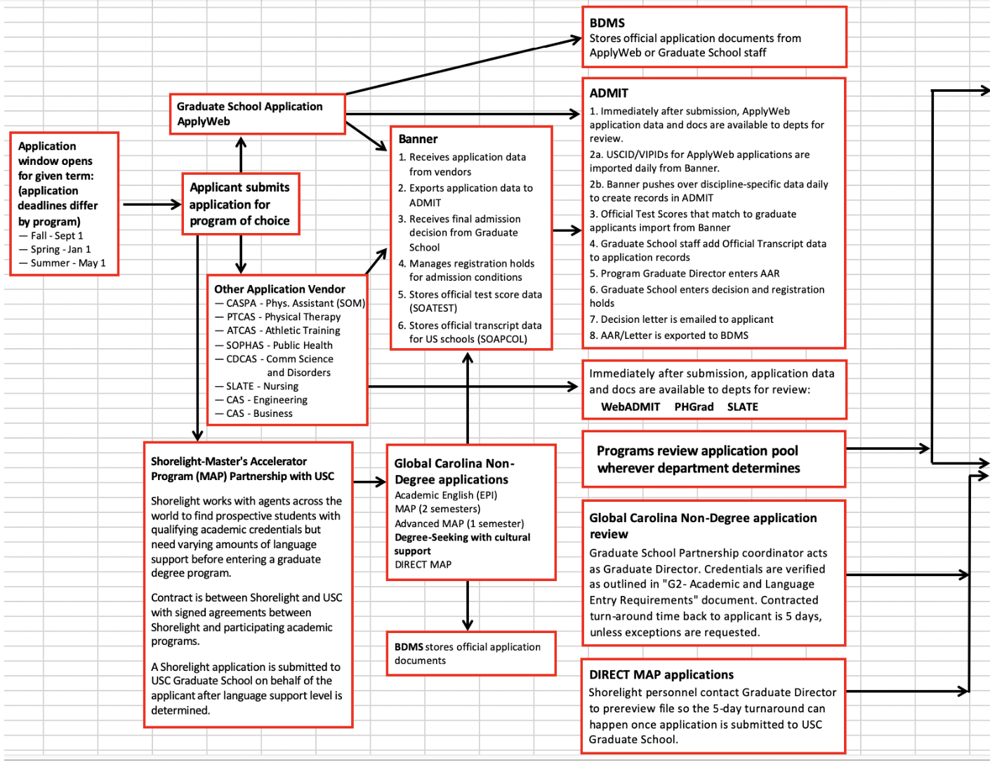
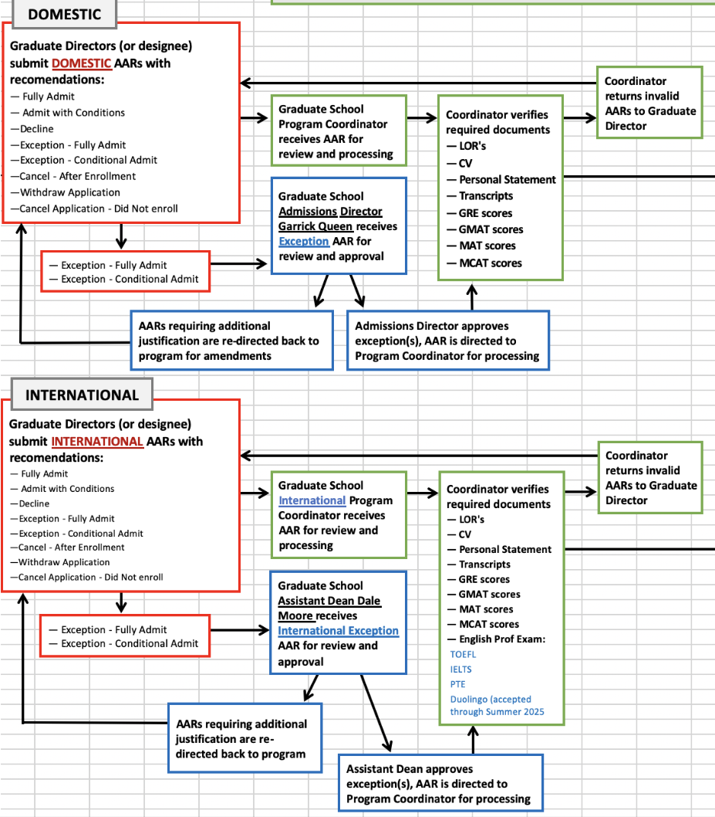
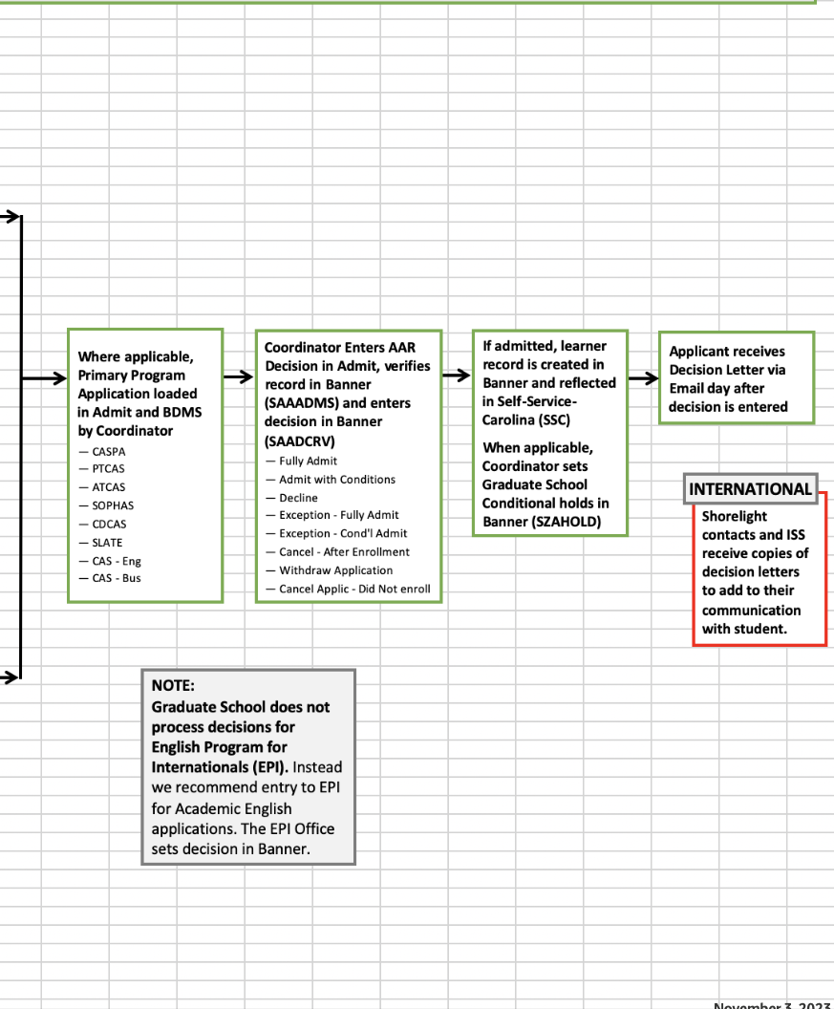
Workflow: Current

Slide 9
Workflow
Questions to answer:
What workflow will reduce inefficiencies?
What workflow will reduce the burden on program staff?
What workflow will reduce the burden on Graduate School staff?
How can workflow be constructed to reduce time to admission decision?

Slide 10
Processes
Recommendations:
Single comprehensive checklist for all application requirements
Communication plan and system
Clearer communication with international students regarding requirements/conditions (in admission letter)
Established timelines for submission of accurate AAR program recommendations that cite any transcript, test score or other conditions.
How-to manual for Graduate School Coordinators
Notes:
Please scrutinize the above action. One of these is completed (manual for Graduate School Coordinators), but not sure whether the others are completed OR being worked on OR will be worked on in the future. Please edit this to make it accurate – or eliminate this slide. → Not sure what the sentence in red means. ←

Slide 11
Processes
Questions to answer:
What processes can be automated?
What processes can be eliminated?
Who should perform each process?

Slide 12
Selection for Graduate Admissions
Review graduate admissions research
The book Inside Graduate Admissions (Julie Posselt) will serve as a focus, with additional relevant readings made available.
The discussion approach will mirror the “reading group” format used last academic year with book The New PhD.
Graduate Directors and Graduate Faculty will be invited to four sessions: August 29 (intro), September 26, October 31, November 21

Slide 13
Why This Is So Important
This will be the first time in 20 years that the University of South Carolina has comprehensively examined and redesigned graduate admissions.
We can position the university for the changing demands of future students and the need for an agile, responsive admissions process.
By working together on this, we can surface great ideas and build them into the new approach to achieve sustainable progress.

Slide 14
Thank You!
Ann Vail
Dean, The Graduate School
ann.vail@sc.edu

